Slide 1

Expense Tracker – Angular SPA
An Interactive Expense Management System Using Angular
By
Gowtham M
TechMahindra Batch 1

Slide 2
About the Application
An Angular Single Page Application (SPA) for managing expenses with friends
Allows users to log in, view friends, track expenses, and manage payments efficiently.
Objective :
Simplify financial tracking among friends.
Provide a user-friendly and interactive interface for expense management.
Ensure seamless navigation and real-time data updates using Angular services and API calls.

Slide 3
Key Features
Single Page Application (SPA) – Fast navigation without reloading.
Component-Based Architecture – Reusable and modular components.
Parent-Child Communication – Uses @Input and @Output for data sharing
Forms Handling –
Login form(Template-Driven)
Expense form(Reactive)
Expense Tracking – Shows amounts owed and received dynamically.
Mock API with JSON Server – Simulates backend data with db.json
Pipes & Directives – Used for formatting and UI enhancements.

Slide 4
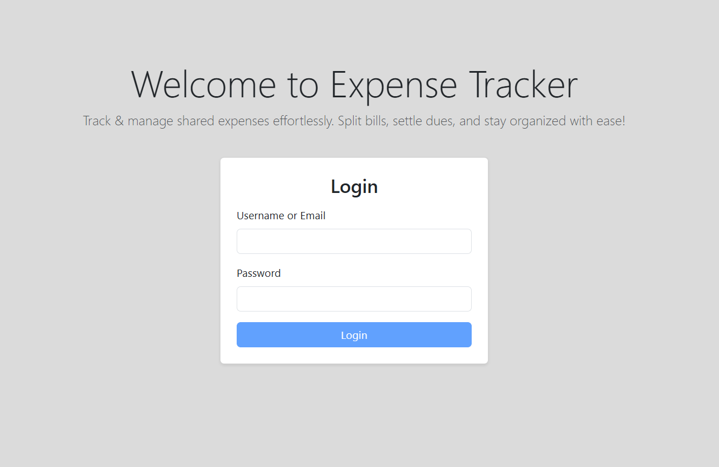
Application Workflow :
Screenshot :
1 ) User Login
User enters credentials in the Login Form (Template-driven-form).
Authenticated using Auth Service.

Slide 5
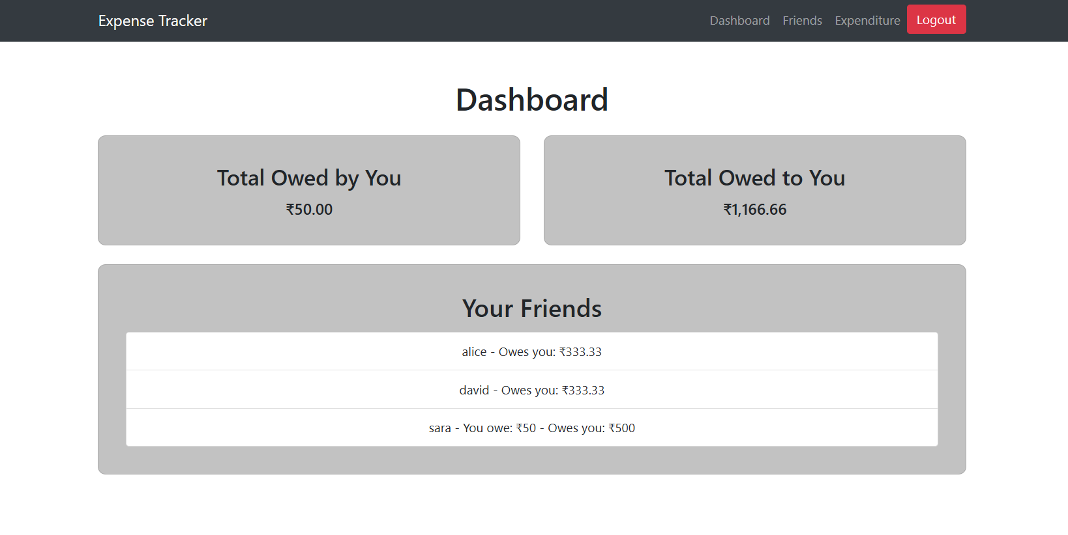
Application Workflow :
Screenshot :
2) Dashboard
Shown after successful login.
Displays expense summary.
Quick access to friends & expenditures.

Slide 6
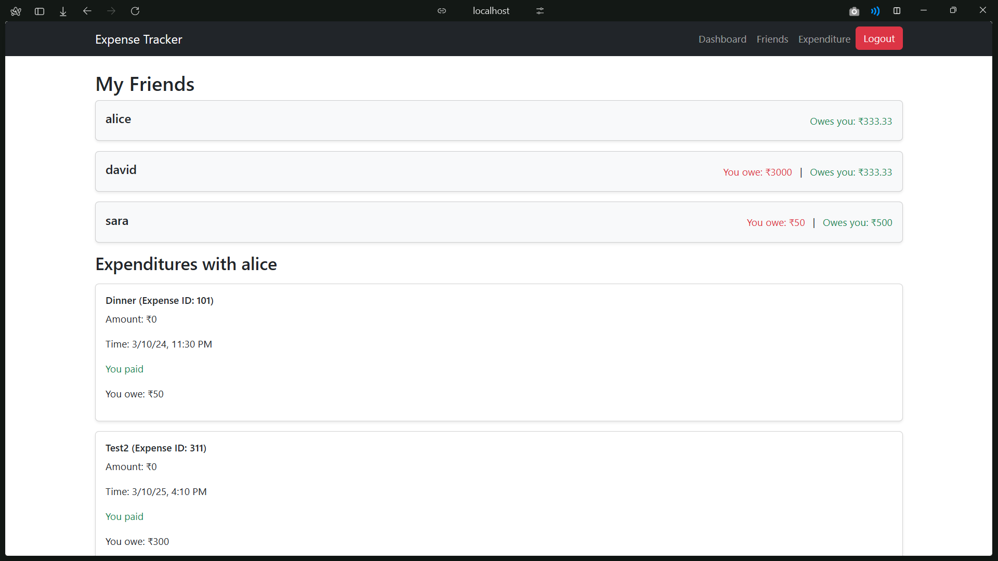
Application Workflow :
3) Friends Page
Lists all friends with owed amounts.
Users can view detailed transactions by selecting a friend.
Screenshot :

Slide 7
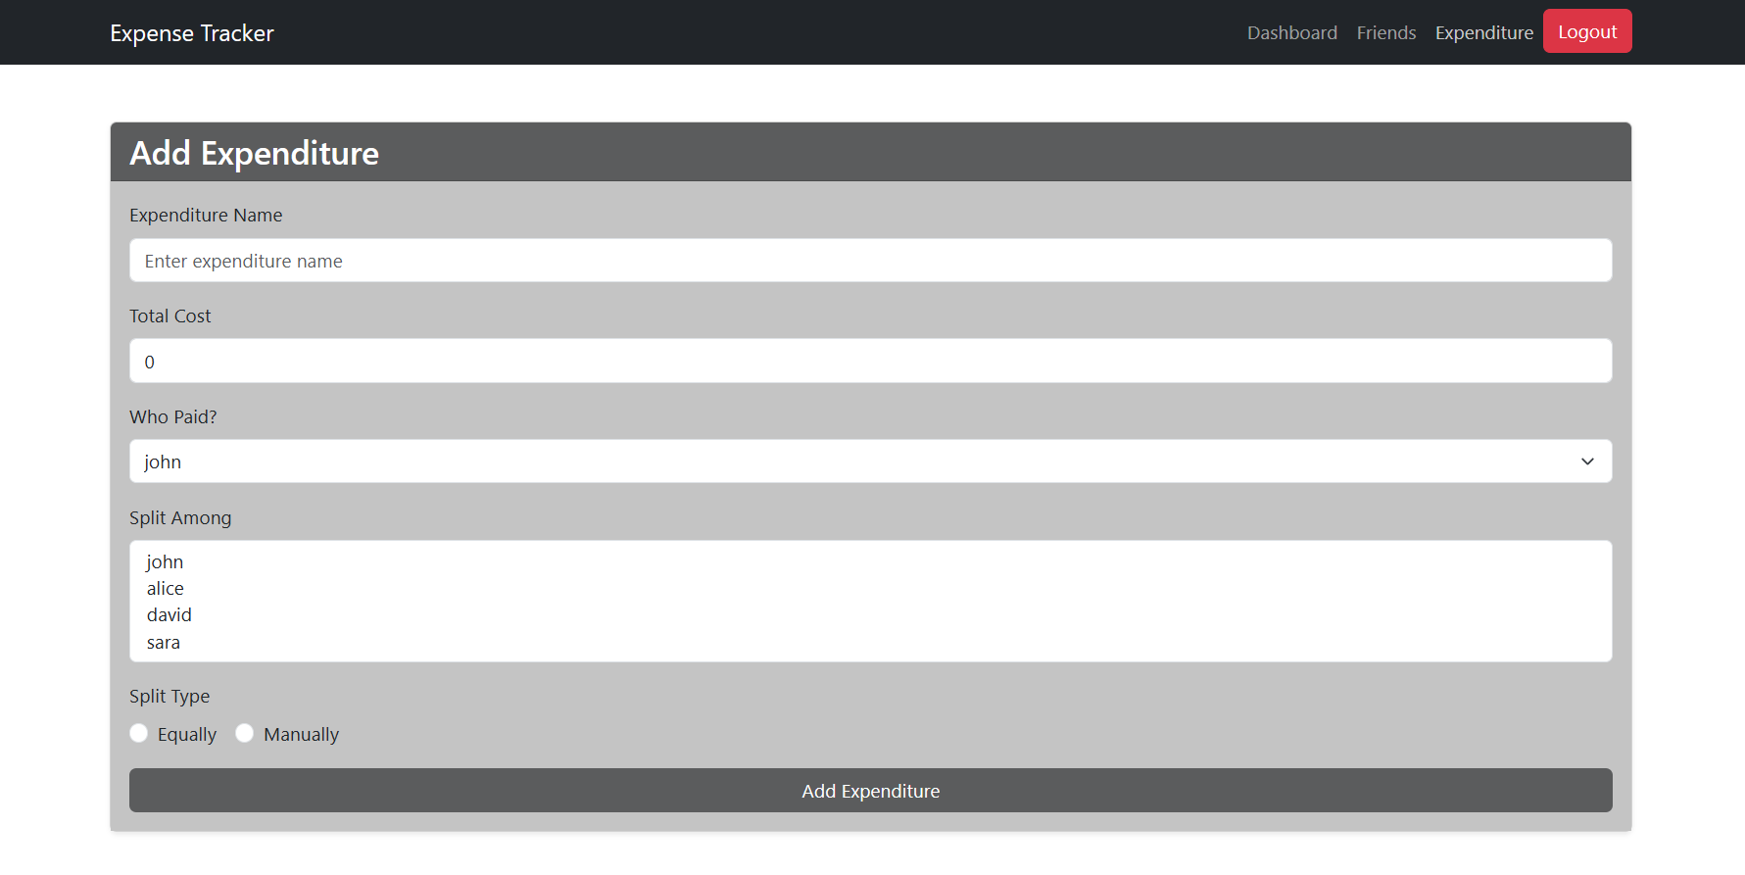
Application Workflow :
4) Expenditure Page
Users can add new expenses.
Uses Reactive Form for input.
Data stored via JSON Server (Mock API).
Screenshot :

Slide 8
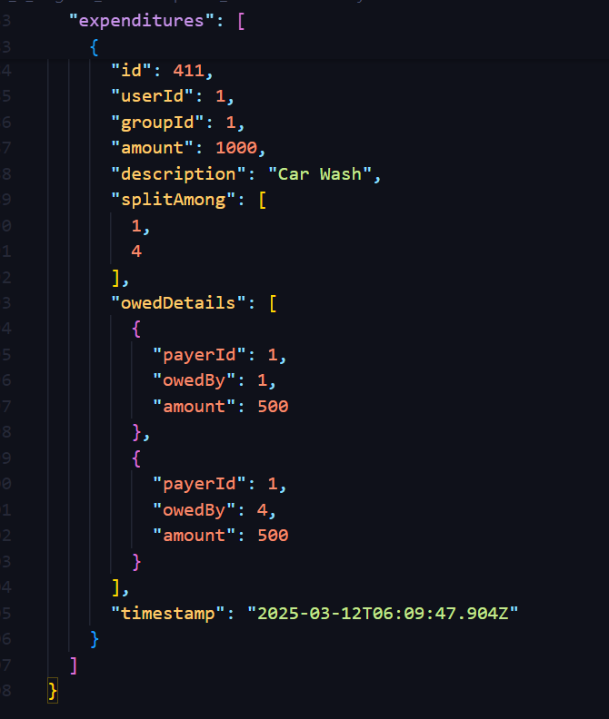
Application Workflow :
5) Data Handling & UpdatesUsers
Observables fetch and update data (Both in UI and Json Server)
Data Handling & Updates
Screenshot :

Slide 9
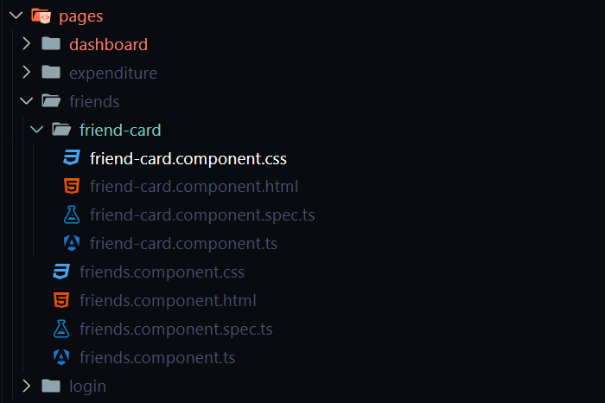
Angular Concepts Used :
Components – Modular design with Dashboard, Friends, Expenditure, Navbar, and Login components.
Parent-Child Components – Data sharing between FriendsPage & Friends Card
}
}
Child
Parent

Slide 10
Angular Concepts Used :
Routing – Navigation between Dashboard, Friends, and Expenditure using Angular Router
Pipes – Used for formatting currency and filtering data.
Directives :
Structural Directives( *nglf , *ngFor ) for dynamic content.
Attribute Directives ( [ngC1ass] ,[ngSty1e] ) for styling.
Forms
Template-driven Form for Login.
Reactive Form for adding expenses.
Services & Observables :
AuthService for authentication.
FriendsService for fetching and updating data.

Slide 11
Technologies Used
Frontend: Built with Angular & TypeScript, using HTML & CSS for structuring and styling.
Backend (Mock API): Uses JSON Server to simulate a backend for managing user data and expenses.
State Management: Implements Angular Services and RxJS Observables to handle data flow efficiently.
Routing: Angular Router enables smooth navigation between pages.
Forms: Utilizes Template-Driven and Reactive Forms for handling user inputs in login and expense entry.
Styling: Designed with CSS and Bootstrap for responsive UI.

Slide 12
Thank you
Gowtham M
gowthamudpm2004@gmail.com
TechMahindra Training Batch 1 (2025)

